Slide 1
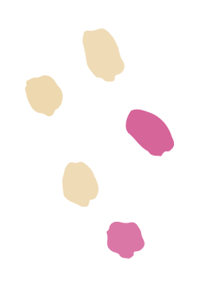
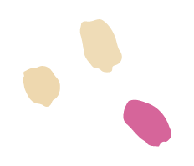
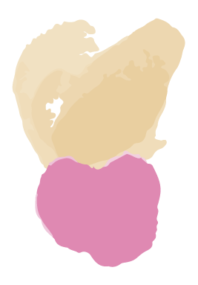

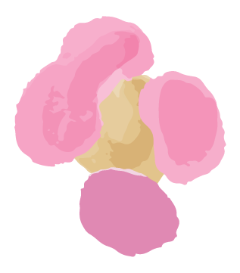
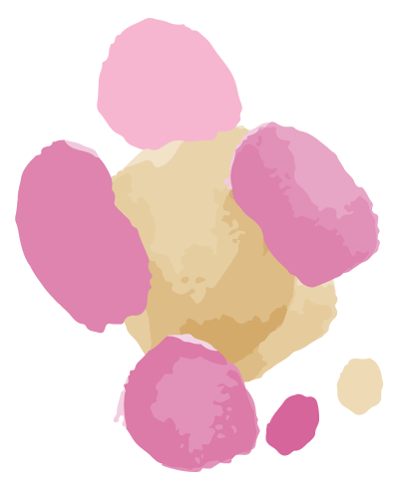
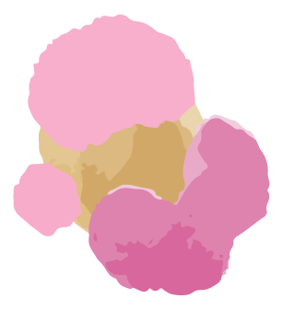
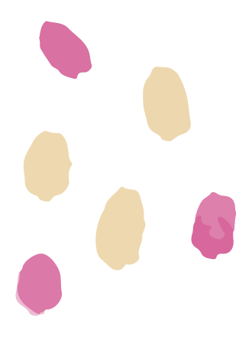
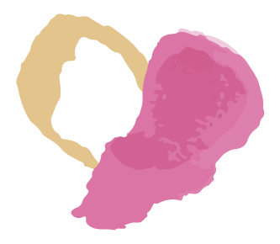
SkinLens
Team Biased
Your Personal Dermatologist

Slide 2
AGENDA
02
01
03
04
Roles & Responsibilities
Improvements
Problem Statement
Project Description
Working Agreement
Personas
MVP
Project Design
Technologies
Algorithms
Diagrams
05
06
07
08
Project backlog
Sprint 1 Summary
Sprint 2:
Stories
Test cases
Completed
Not completed
Sprint 2 Metrics:
Velocity
Burndown Charts
Committed Ratio
Sprint 2 Retrospective
Sprint 3 Planning
Project Demo and APIs

Slide 3
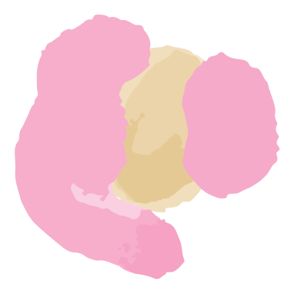
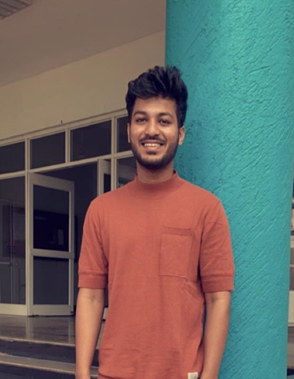
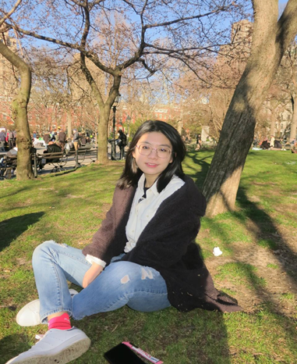
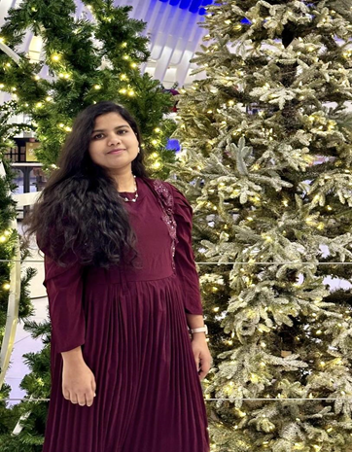
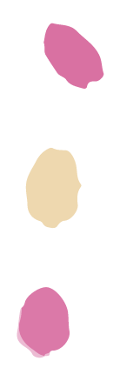
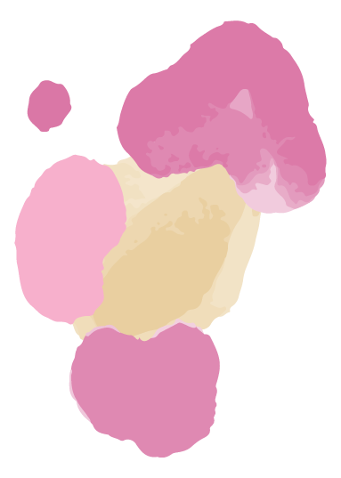
Roles and Responsibilities
MOHAMMAD ZAID
TEAM LEADER/DEVELOPER
ZHUOWEN YAN
SCRUM MASTER/DEVELOPER
NAGANJALI PUJITHA KALLI
DBA/DEVELOPER

Slide 4
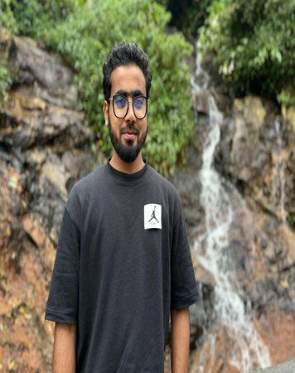
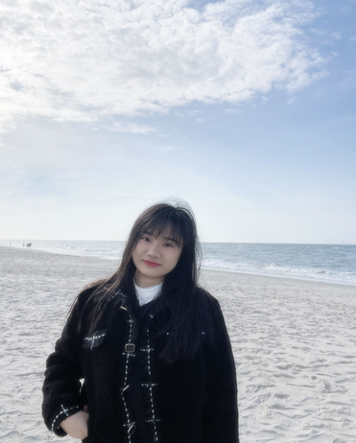
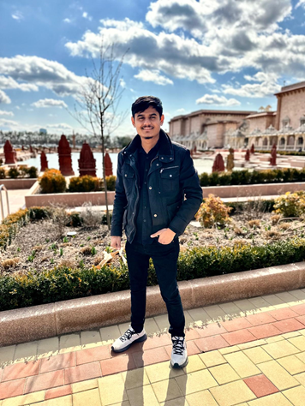
Roles and Responsibilities
MOHAMMED TANZIL
DEVELOPER/TESTER
BANGLING YIN
DEVELOPER
ABHIKUMAR PATEL
DEVELOPER/TESTER

Slide 5

IMPROVEMENTS
Story Points according to fibonacci number
Headings on all pages
Split bigger user stories into small user stories
Separate Tasks from user stories
Use Given, When, Then in acceptance Criteria
Clear distinctions between user stories completed and not completed
Marker

Slide 6
WHAT PROBLEM ARE WE SOLVING?
Accurate and timely diagnosis of skin diseases is a challenge because:
Limited availability of dermatologists in remote areas
Traditional methods primarily involve only visual inspection of the skin which may be prone to human error or variability in interpretation.
What does it affect?
This results in delayed diagnosis, limited personal care and possibly worsening of skin diseases.

Slide 7
PROJECT DESCRIPTION
A web-based platform to help patients diagnose skin conditions using deep learning.
Intended for patients who wants to quickly access their skin conditions, skinLens integrates image analysis to provide accurate diagnosis of skin diseases and recommend treatments.
Intended for dermatologists who wants to efficiently access patient’s skin conditions.
Unlike traditional visual inspections, SkinLens uses advanced image-based deep learning model and offers accurate predictions and recommend treatments along with real-time consultation with dermatologists.
Benefits - Improved diagnose accuracy, faster and personalized care, increased accessibility, reduced costs and real-time access to consultations with dermatologists.

Slide 8
PROJECT DESCRIPTION
Project Name: | SkinLens
Team: | Team Biased
Project Description: | For patients who wants to quickly access their skin conditions, for dermatologists who wants to quickly access patient’s skin conditions SkinLens is a web application that integrates image analysis to provide accurate diagnosis of skin conditions and recommend treatments along with real-time consultation with dermatologists. Unlike traditional visual inspections, SkinLens uses advanced image-based deep learning model and offers accurate predictions and recommend treatments.
Benefit Outcomes: | Improved diagnose accuracy, Faster and personalized care, Increased accessibility, Reduced costs, Real Time consultation with Dermatologist.
GitHub Link: | https://github.com/htmw/2024F-Biased/wiki

Slide 9
Team Working Agreement
Communication expectations
Meeting structure and frequency
Meetings will be held via zoom
Daily scrum at 8pm for 15 minutes.
A follow-up meeting should be planned after the daily scrum if there are any blockers that can’t be addressed quickly.
A meeting for Sprint Planning will be planned at the beginning of the Sprint.
A meeting for Sprint Retrospective will be planned before the Sprint end date.
Encourage everyone to actively participate in the meeting.
We will adhere to agreed meeting time and will inform the team of any absences.
Any changes in the timings will be mutually decided.
Meeting minutes with objectives and decisions will be recorded in a Google Sheet.
If you miss a meeting, support decisions made in your absence.
Scrum Master should host the meeting and control time.
All communications will be through Slack.
Opinions and ideas of all team members will be respected.
Changes, if any, should be discussed and agreed within the team.
Conflicts should be focused on issues and not individuals. (Strictly avoid blame game)
Unresolved conflicts among the team should be reported to the team leader.
We encourage everyone to express their frustrations and discomfort early.
Clear understanding and listening to others are the most important things to resolve conflicts.

Slide 10
Team Working Agreement
Team norms and values
Continuous Improvement
Each team member understands their roles and responsibilities.
We divide tasks transparently and help each other **When** necessary.
Each task should have a clear due date and mutually accepted definition of “Done”.
Each team member takes responsibility for their tasks and for achieving the team's goals.
Team members should report obstacles immediately if they cannot complete their work on time, and actively contribute to the solution.
Team members should update their task’s process via Jira before the daily scrum meeting.
Team members should upload their work to prescribed places like GitHub or Google Drive before the daily scrum meeting.
Encourage teams to research, learn, come up with new ideas and share with the team.
We will reflect on areas of improvement during each Sprint Retrospective so that our process is better for the next sprint.
Definition of DONE
Work has been fully reviewed by another team members.
Code can run and no errors.
All tests are successfully completed.
No critical defects.
Work meets the acceptance criteria.
Code pushed to GitHub.
Documentation has been updated.

Slide 11
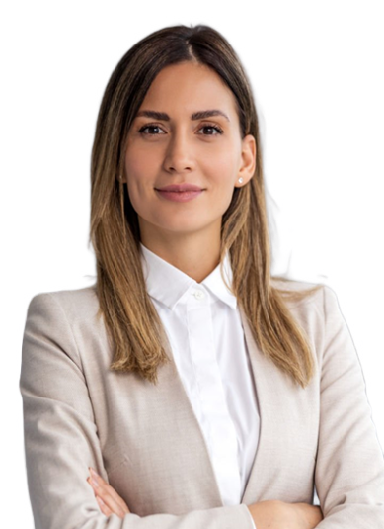
PATIENT PERSONA
Nashley is a busy professional person, living in a city and has sensitive skin prone to rash and acne.
Challenges:
She has skin issues and often experiences delays in scheduling appointments with dermatologists.
Finds very difficult to describe disease accurately and fears misdiagnosis due to lack of knowledge.
Concerned about long-term skin damage and wants fast treatment options.
Goals:
She wants a reliable, easy-to-use platform to self-access skin issues quickly and get initial feedback without needing to wait for appointments.
Hopes to receive personalized treatment recommendations based on her skin type, age, and medical history.
Nashley Pagiroli
Age: 30
Gender: Female Occupation: IT Employee

Slide 12

PARENT PERSONA
Gloria is a housewife balancing taking care of four children,household duties, and her husband,leaving her with little time to focus on individual healths.
Challenges:
Frequently deals with minor skin issues like rashes or eczema among her kids.
Finds to gets confused especially when it comes to skincare for different ages and skin types.
Concerned about the cost and time required for multiple doctor visits, particularly for non-serious conditions.
Goals:
Seeks personalized advice for each children skincare with their unique needs like skin type, allergies, or past treatments.
Hopes to save time by using images and she uploads.
Wants peace of mind by receiving accurate, clear advice and thinks homecare is sufficient.
Gloria Garson
Age : 40
Gender : Female Occupation : House wife

Slide 13

DOCTOR PERSONA
Dr. Robert is working in both a hospital and private clinic, treating a high volume of patients with various skin conditions.
Challenges:
Manages a large patient load daily, leading to limited time for each consultation and difficulty providing personalized care.
Often receives incomplete descriptions of diseases, making it challenging to diagnose accurately without further testing or follow-ups.
Struggles to track patient treatment outcomes over time,like eczema or psoriasis, due to irregular follow-ups or inconsistent data from patients.
Goals:
Wants a platform of patient information, including images, and medical history, allowing for quick.
Hopes to tracks patient progress over time, helping to adjust treatments.
Aims to reduce the patient times.
Dr. Robert Smith
Age : 35
Gender : Male
Occupation : Dermatologist

Slide 14
MVP (Minimum Viable Product)
Web-Based Interface:
User-friendly platform accessible to patients and dermatologists.
Patient Image Upload:
Secure and intuitive feature for patients to upload skin condition images.
Supports multiple images per case for comprehensive analysis.
AI-Powered Diagnosis:
Utilizes a pre-trained image classification model to process uploaded images.
Provides fast and accurate diagnosis results for 20+ skin conditions.
Diagnosis Display:
Clear and concise results displayed to the patient with an option to generate report, including:
Predicted skin condition.
Brief description of the diagnosis.
Actionable treatment recommendations.

Slide 15
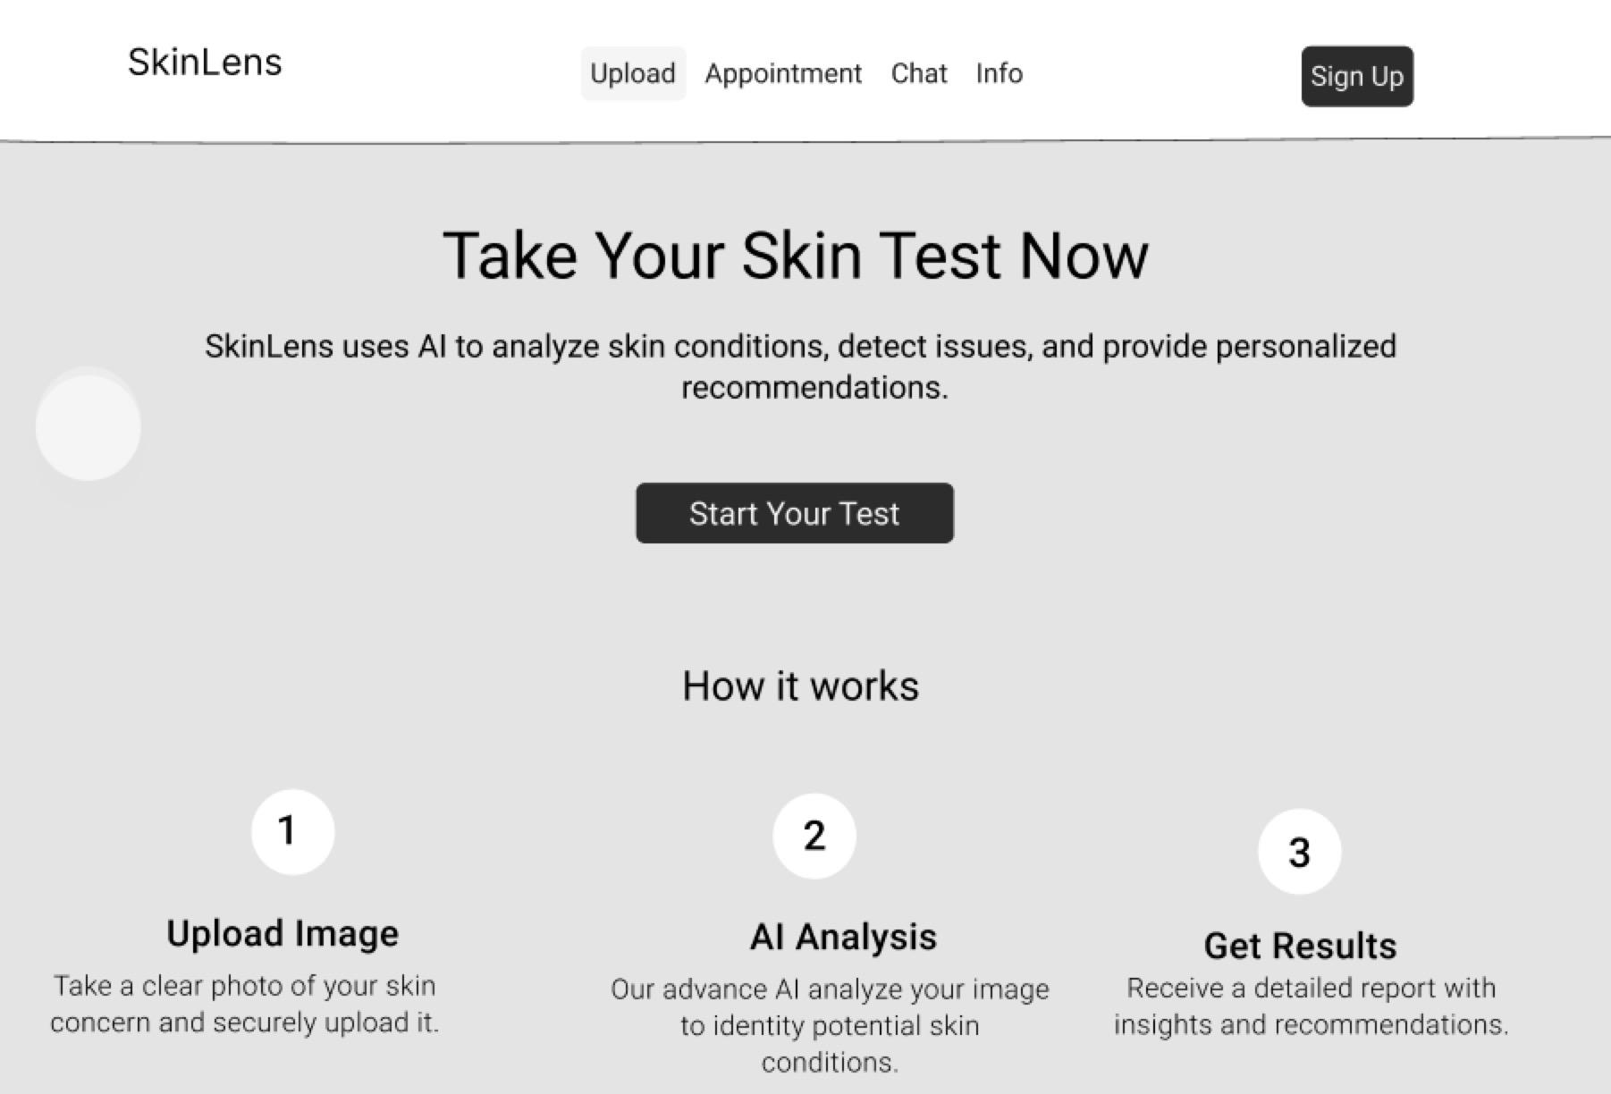
Project Design (Figma)

Slide 16



















Technologies
Front-end & Back-end & Database
AI Model
Tools

Slide 17

REACT+VITE AND TAILWIND CSS
REACT: It is an open source JavaScript library.
It used to create interactive and reactive user interfaces. We can split UIs into reusable components, which can make it easier to maintain and build large web applications.
VITE: It is a fast and good web application build tool. It stands out for its fast startup and instant compilation times during development.
TAILWIND CSS: It is an open source css framework.
It encourages a more direct approach to styling.

Slide 18

FLASK
SkinLens utilizes a flask-backend server.
Lightweight Python Web Framework: Flask is a micro-framework that allows for easy and flexible development of web applications and APIs.
API development: Used to create RESTful API endpoints for handling requests from the frontend.
Routing: Flask handles routes that correspond to different functionalities (e.g., image upload, retrieving diagnoses).
Integration with AI Models: Flask acts as a middleware between the frontend and the ResNet50 image classification model for handling requests and returning diagnoses.
Easy Integration with Databases: Flask communicates with Firebase (Firestore and Storage) to store and retrieve data such as images and diagnosis reports.

Slide 19
CORS
Axios
Cross Origin Resource Sharing
Security Feature: Prevents web pages from making requests to a different domain than the one serving the web page.
Handling Cross-Origin Requests: Needed to enable requests from the frontend (React) to the backend (Flask), especially **When** hosted on different servers or ports.
Flask-CORS: A Flask extension used to handle CORS settings, allowing the frontend to securely access the API.
Configuration: Configured in the Flask app to allow requests from the frontend domain, specifying allowed HTTP methods (GET, POST, etc.)
JavaScript HTTP Client: Axios is a promise-based library used to make HTTP requests from the frontend (React).
Simplifies API Calls: Handles API requests (GET, POST) and responses for operations like uploading images and retrieving diagnoses.
Error Handling: Provides built-in support for handling errors and network issues in the API requests.
Asynchronous Operations: Supports asynchronous requests, allowing the app to remain responsive while waiting for the backend to process data.

Slide 20
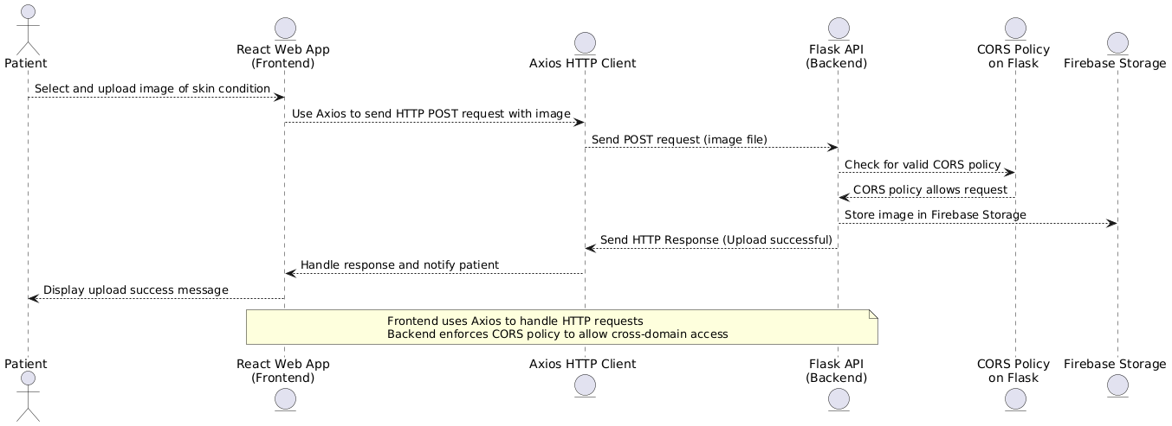
CORS and Axios functioning

Slide 21

FIREBASE INTEGRATION IN SKINLENS
Key Features of Firebase in SkinLens:
Authentication:
Enables secure login and signup for patients and dermatologists.
Role-based authentication to manage access to dashboards and reports.
Firestore Database:
Stores user profiles (name, email, role, UID) securely.
Maintains cases and reports, including metadata, predictions, descriptions, and treatment recommendations.
Firebase Storage:
Securely stores uploaded skin condition images.
Organizes images by unique case IDs for easy retrieval.
Security & Scalability:
Implements Firebase's built-in security rules to ensure data privacy.
Scales effortlessly to handle multiple users and large datasets.
Why Firebase?
Simplifies backend management.
Provides seamless integration for authentication, storage, and real-time updates.
Ensures high reliability and scalability for a healthcare-focused application.

Slide 22
ALGORITHMS:
Used TensorFlow and keras for the CNN Model and Data Augmentation.
OpenCv library for image preprocessing.
Matplotlib for visualization.

Slide 23
CNN Architecture:
Model Layers:
Convolutional Layers: These layers extract features like edges, textures, and shapes from the images.
Max Pooling: These layers reduce the spatial dimensions of the feature maps, making the model more efficient and reducing overfitting.
Dropout: Randomly sets some neurons to zero during training to prevent overfitting.
Flatten Layer: Converts the 3D feature maps into a 1D vector, preparing it for the fully connected layers.
Dense Layer: The final output layer that classifies the images into one of the 5 classes using softmax activation.
Batch Normalization:Normalizes the output from the convolutional layer to stabilize and accelerate training.
Softmax Activation :The softmax function converts the raw output scores into probabilities. It ensures that the sum of the output probabilities for all classes equals 1, making it suitable for multi-class classification.
Key Parameters:
Optimizer: Adam.
Loss Function: Categorical Cross-entropy (for multi-class classification).

Slide 24
Project Schedule
Sprint 0
Sprint 1
Sprint 2
Sprint 3
Sep 6 - Sep 26
Sep 26 - Oct 24
Image upload
AI diagnosis
Oct 24 - Nov 21
More conditions
More accuracy
Brief description
Treatments
Report feature
Database
Nov 21 - Dec 12
More accuracy
User account management
Derm review
Real-time chat

Slide 25
Diagrams

Slide 26
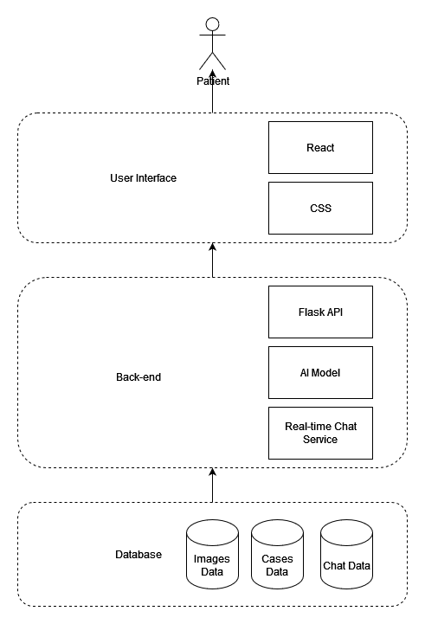
Architecture Diagram

Slide 27
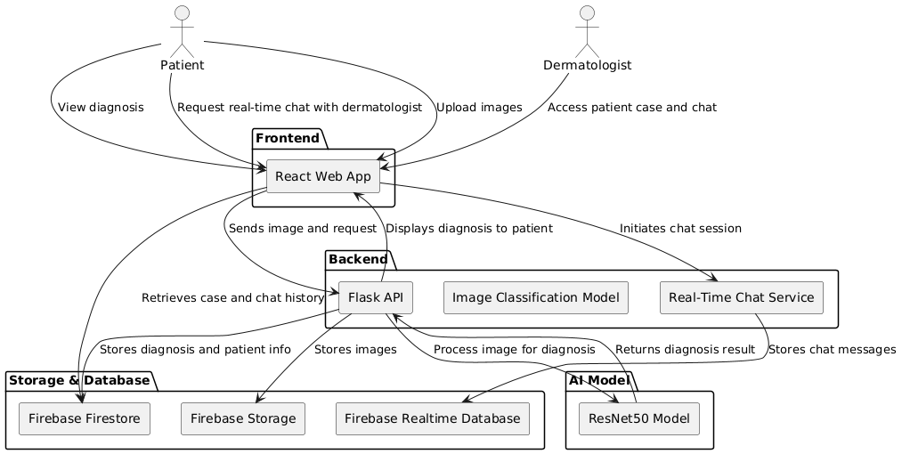
Architecture Diagram

Slide 28
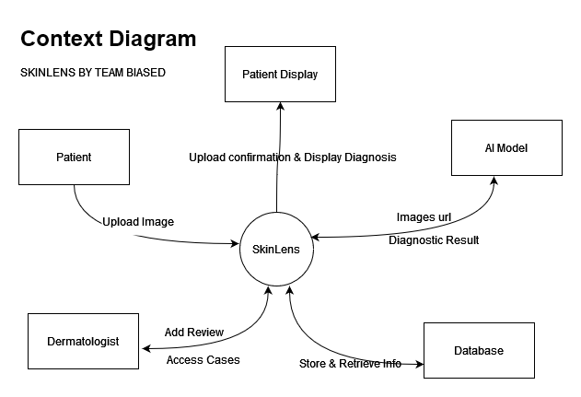
Context Diagram

Slide 29
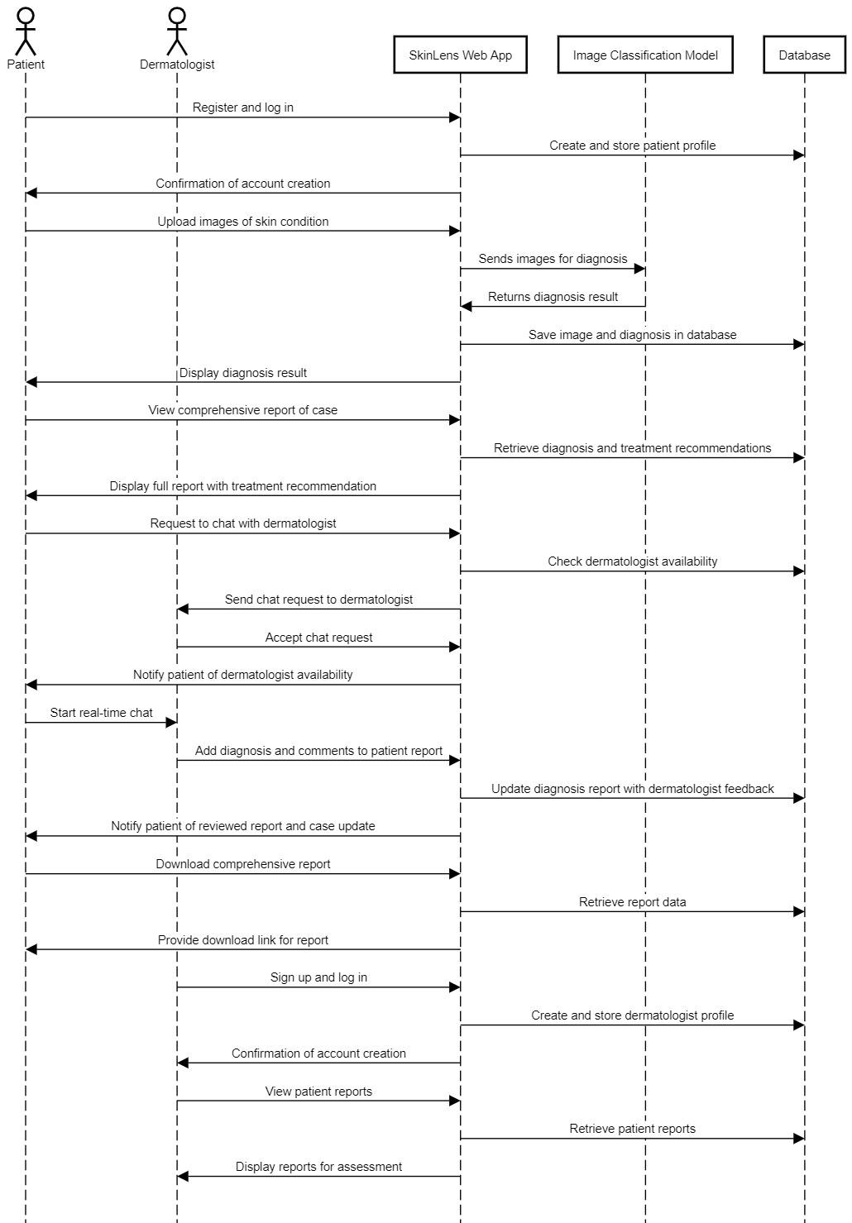
Sequence Diagram

Slide 30
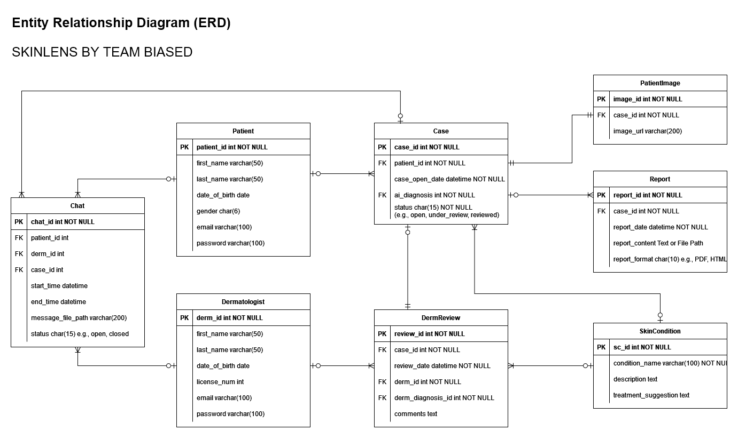
ER Diagram

Slide 31
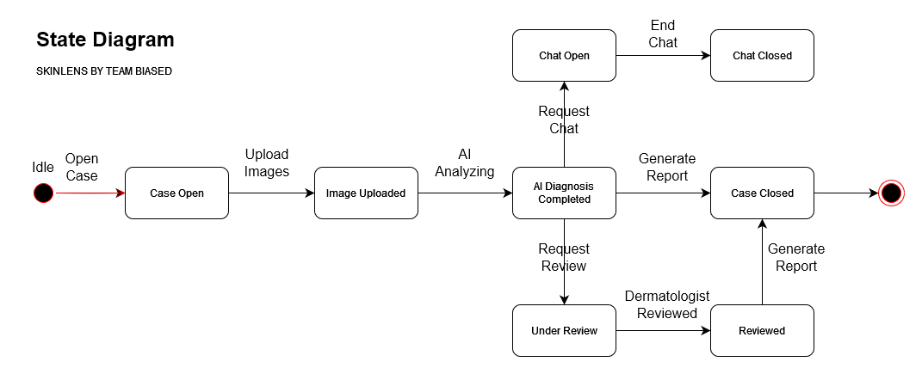
State Diagram

Slide 32
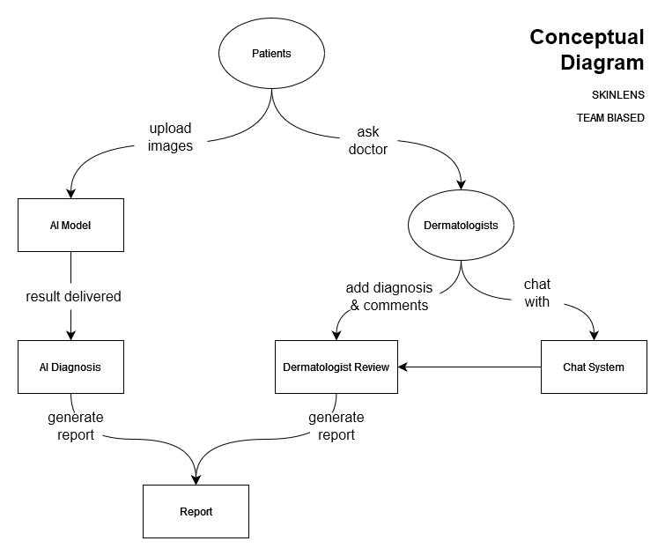
Concept Diagram

Slide 33
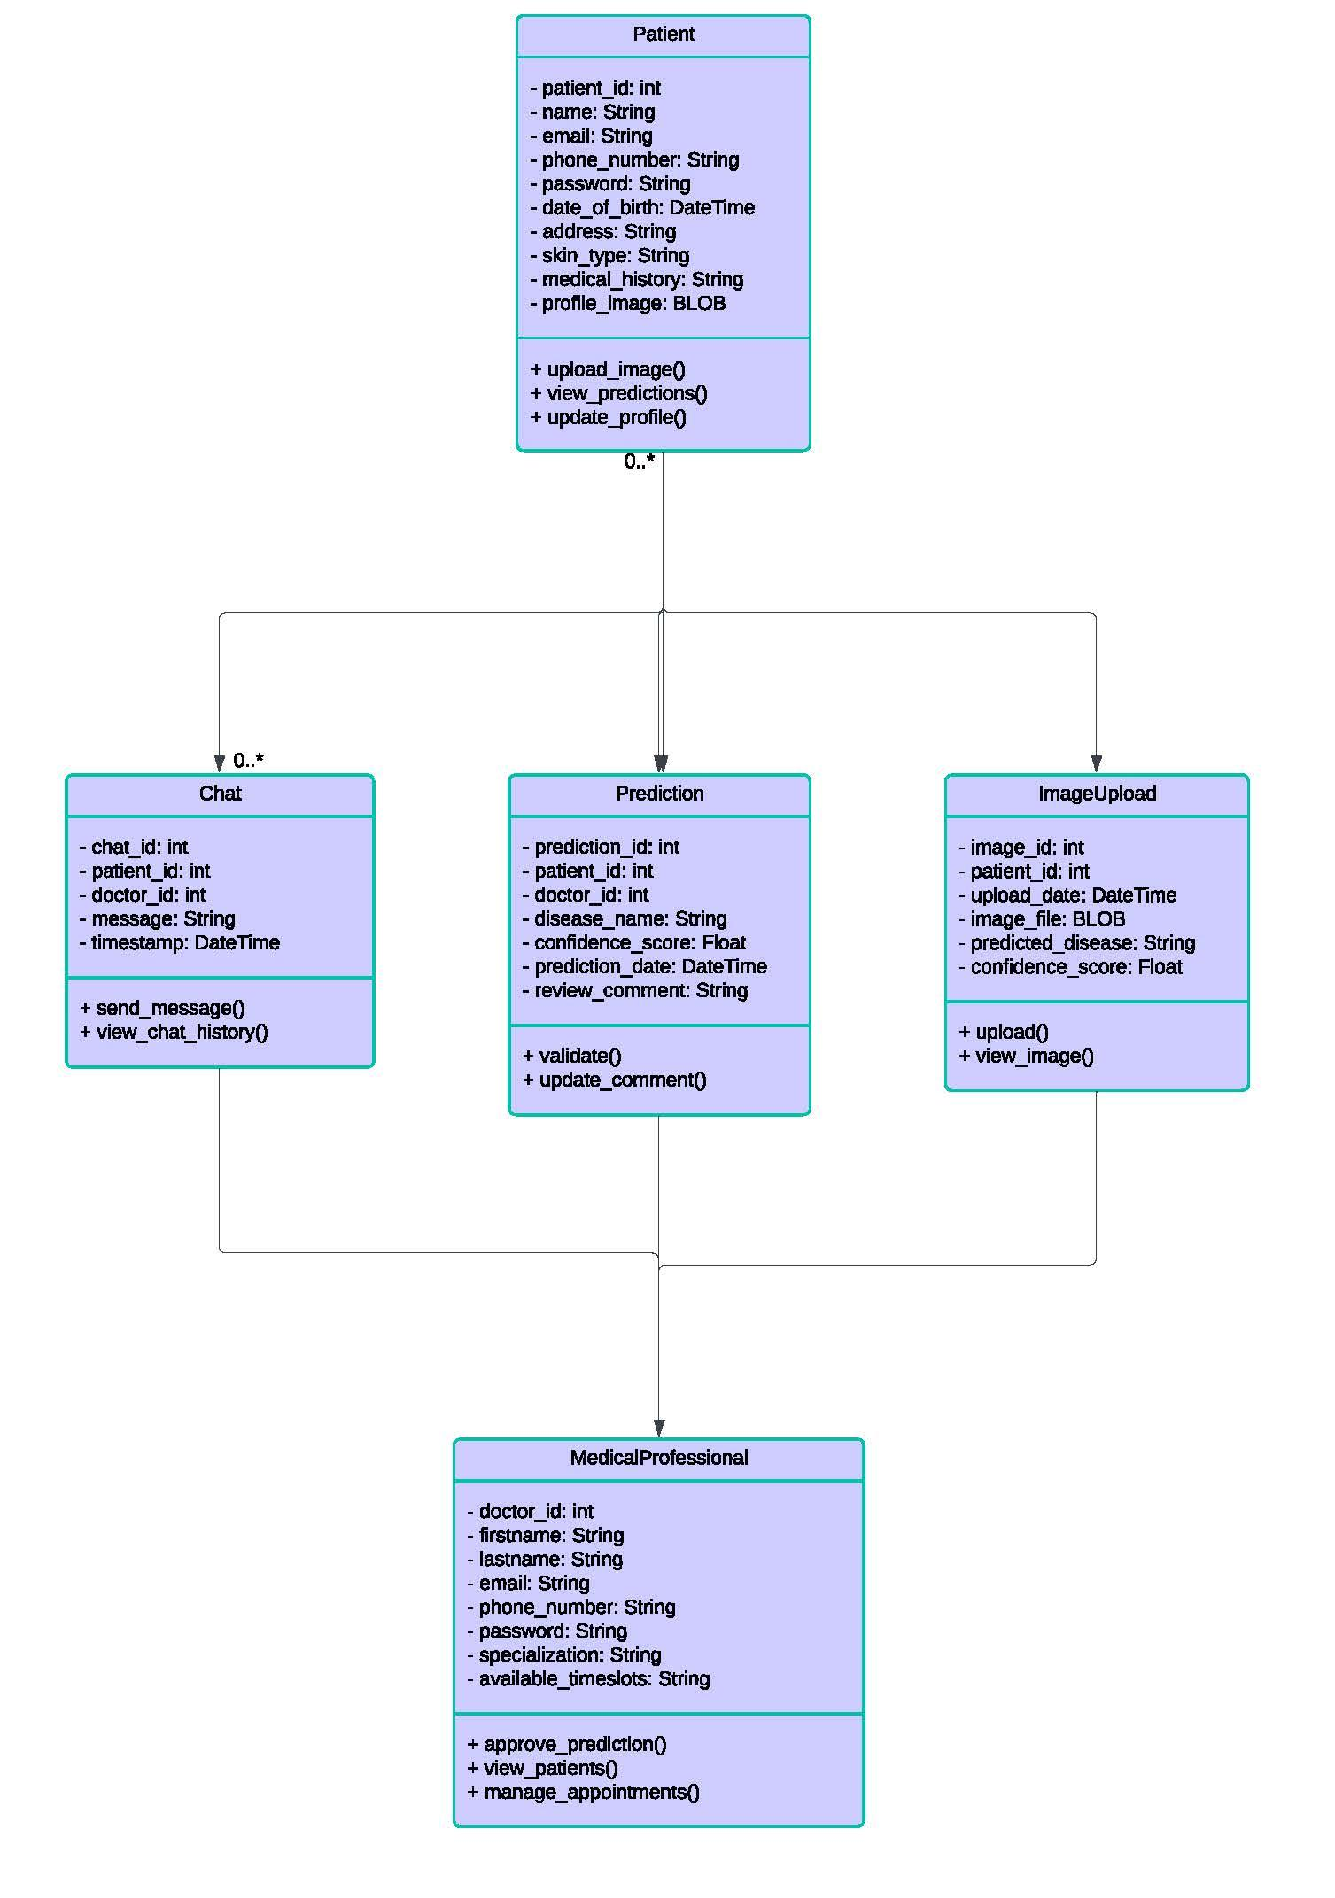
Class Diagram

Slide 34
Sprint 1 Summary
Set up React + VITE front-end server
Set up Flask back-end server
Finalized a Figma design
Created React front-end for homepage
Created React front-end for image-upload page
Queried dataset and formatted labels
Developed the training file and executed it on Colab

Slide 35
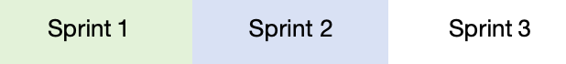
PRODUCT BACKLOG
No. | User Stories | Acceptance Criteria | Feature | Story Points
US_01 | As a patient, I want to access a home page and start a new case so that I can begin my skin condition assessment. | Access Home Page: Given the patient opens the application, When they navigate to the home page, Then the home page is displayed with options to start a new case and clear instructions on how to use the app. Start New Case Button: Given the patient is on the home page, When they click the "Start New Case" button, Then they are directed to the new case interface. | Image Upload | 2
US_02 | As a patient, I want to access an interface to upload images so that I can provide information about my skin condition. | Access Upload Interface: Given the patient starts a new case, When they proceed to the image upload step, Then an interface appears where they can upload images. Image Selection Options: Given the patient is on the image upload interface, When they choose to upload an image, Then they can either select an image from their device or drag and drop it onto the upload section. | Image Upload | 5
US_03 | As a patient, I want to select an image from my device and upload it so that it can be used for diagnosis. | The patient can select a single image file from their device. The system accepts specified formats (e.g., JPEG, JPG, PNG). | Image Upload | 5
US_04 | As a patient, I want to receive a confirmation message and see a preview of my uploaded image so that I know it was uploaded successfully. | Confirmation Message: Given the patient uploads an image successfully, When the system completes the upload process, Then a confirmation message is displayed on the screen. Image Preview: Given the image is uploaded successfully, When the system processes the image, Then a thumbnail preview of the uploaded image is displayed on the interface. | Image Upload | 2

Slide 36
PRODUCT BACKLOG
No. | User Stories | Acceptance Criteria | Feature | Story Points
US_05 | As a patient, I want the app to analyze my image and recognize basic types of skin conditions so that I can receive a preliminary diagnosis. | Model Triggers Analysis: Given the patient has successfully uploaded an image, When they click the "Analyze" button, Then the app uses the trained AI model to classify the skin condition. Initial Classification Accuracy:Given the model is trained to recognize 5 common skin conditions, When an image is analyzed, Then the prediction results are displayed based on the model's classification accuracy. | AI Diagnosis | 8
US_06 | As a patient, I want to receive the diagnosis as the name of the condition so that I can understand the skin issue. | Display Diagnosis Name: Given the model completes the analysis, When a diagnosis is generated, Then the name of the skin condition is displayed clearly on the patient’s screen. Readable Format: Given the diagnosis is presented to the patient, When it is displayed, Then the name of the condition is shown in an easy-to-read and user-friendly format. | AI Diagnosis | 5
US_07 | As a patient, I want the uploaded image to be securely stored so that I can access my report anytime. | Secure Image Storage: Given the patient uploads an image, When the upload process is successful, Then the image is securely stored in Firebase Storage with a unique case ID. Image Accessibility: Given the patient has logged into their account, When they access their case details, Then all stored images are displayed and linked to the relevant case. | Image Handling | 3
US_08 | As a guest user, I want my uploaded image to be deleted after processing so that it doesn’t remain stored unnecessarily. | Automatic Deletion: Given the guest uploads an image, When 5 minutes have passed after upload, Then the image is automatically deleted from Firebase Storage. | Image Handling | 2

Slide 37
PRODUCT BACKLOG
No. | User Stories | Acceptance Criteria | Feature | Story Points
US_09 | As a guest user, I want the system to alert me if my temporary image is unavailable after the session so that I can re-upload it. | Image Unavailable Alert:Given the guest's temporary image is deleted due to timeout, When they attempt to proceed, Then the system displays an alert notifying them about the unavailability. Re-Upload Option: Given the guest's image is deleted, When they choose to upload a new image, Then the system provides an option to re-upload. | Image Handling | 1
US_10 | As a patient, I want clear error messages if something goes wrong during upload or prediction so that I can take corrective actions. | Error Messages for Uploads: Given the patient uploads an invalid file or encounters a failed upload, When the system detects an issue, Then an error message is displayed explaining the problem and steps to resolve it. Retry Options: Given an error occurs during upload or prediction, When the patient chooses to retry, Then the system provides a retry button to reattempt the process. | Image Handling | 1
US_11 | As a patient, I want the app to recognize a wide range of skin conditions so that I can receive a diagnosis for diverse issues. | Wide Range of Conditions: Given the patient submits an image, When the diagnosis is completed, Then the app provides predictions for 20+ skin conditions with clear names. | AI Diagnosis | 5
US_12 | As a patient, I want the diagnosis accuracy to be improved so that I can trust the AI’s results. | Model Accuracy Improvement: Given the AI model is retrained with additional data, When new predictions are made, Then the accuracy threshold meets or exceeds 80% for common conditions. | AI Diagnosis | 5

Slide 38
PRODUCT BACKLOG
No. | User Stories | Acceptance Criteria | Feature | Story Points
US_13 | As a patient, I want to receive the diagnosis result as soon as possible so that I can act quickly if needed. | Fast Processing Time: Given the patient uploads an image for diagnosis, When the system processes the request, Then the results are displayed within 1 minute. Delay Notification: Given processing exceeds the expected time, When the patient waits, Then the system informs them of the delay and provides an estimated wait time. | AI Diagnosis | 2
US_14 | As a patient, I want to receive a brief description of the diagnosed condition so that I can understand about the skin issue I am facing. | Brief Description:Given the diagnosis is completed, When the result is displayed, Then a brief description is provided in clear, understandable language, including common symptoms and causes. | AI Diagnosis | 2
US_15 | As a patient, I want to receive treatment recommendations so that I can take action towards treating my skin condition. | Treatment Recommendations:Given the patient receives a diagnosis, When the system displays the result, Then evidence-based treatment recommendations are provided, including over-the-counter remedies or advice to seek professional care. | AI Diagnosis | 2
US_16 | As a patient, I want to view a comprehensive report of a case so that I have a complete record of my skin condition assessment. | View Comprehensive Report:Given the patient accesses their case, When they open the report, Then it includes metadata, patient details, uploaded images, diagnosis, descriptions, and treatment recommendations. | Report | 5

Slide 39
PRODUCT BACKLOG
No. | User Stories | Acceptance Criteria | Feature | Story Points
US_17 | As a patient I want to download a detailed report as a PDF so that I can share it with a dermatologist or keep it for personal records.. | Downloadable Report: **Given** the patient opens their report, When they click the "Download PDF" button, Then a PDF version of the report is generated and downloaded, matching the layout of the web application. | Report | 1
US_18 | As a patient, I want the ability to print my report directly from the app so that I can have a hard copy **When** needed. | Print Report: Given the patient opens their report, When they click the "Print" button, Then a printable version of the report is generated with a clear and professional layout. | Report | 1
US_19 | As a patient, I want my reports to be secure and accessible only by me so that my medical data remains private. | Secure Access:Given the patient logs into their account, When they access their reports, Thenthe system verifies their identity and ensures only they can view the data. Data Security:Given the patient’s reports are stored, When the system handles data, Then secure storage methods like Firebase and Firestore encryption are used to ensure privacy. | Report Security and Privacy | 2
US_20 | As a patient, I want to view my past cases and track their statuses, so that I can monitor my health progress and stay informed about the evaluations. | Case History Access: Given the patient logs into their account, When they navigate to the "Case History" section, Then they can view a chronological list of all past cases. Real-Time Status Updates: Given the patient views their case list, Then the status of a case changes, Then the system updates the status in real time without requiring a refresh. Navigation to Report:Given the patient clicks on a case entry, When the system processes the request, Then the patient is navigated to that case’s report. | User Account Management | 2

Slide 40
PRODUCT BACKLOG
No. | User Stories | Acceptance Criteria | Feature | Story Points
US_21 | As a dermatologist, I want to access and view patient reports so that I can assess their conditions and provide professional feedback. | Access Reports Dashboard: Given the dermatologist logs into their account, When they navigate to the dashboard, Then a list of all assigned patient reports is displayed. Report Sorting Options:Given the dermatologist is on the reports dashboard, When they apply sorting filters (e.g., by date, status, or patient ID), Then the system dynamically updates the displayed list. | User Account Management | 2
US_22 | As a dermatologist, I want to add my diagnosis to patient reports so that I can contribute my professional assessment to the patient's case. | Select Diagnosis: Given the dermatologist opens a patient report, When they select a diagnosis from the predefined skin condition list, Then the selected diagnosis is added to the report. Submit Diagnosis: Given the dermatologist enters their diagnosis, When they click the "Submit" button, Then the report status changes to "Reviewed," and the diagnosis is visible to the patient. | Derm Review | 2
US_23 | As a dermatologist, I want to add comments to patient reports so that I can provide additional guidance if necessary. | Add Comments: Given the dermatologist opens a patient report, When they enter comments in the designated text field, Then the comments are saved and associated with the report. Visibility of Comments: Given the dermatologist submits comments, When the patient views the report, Then the comments are displayed in the relevant section. | Derm Review | 1
US_24 | As a patient, I want to be notified as soon as my report is reviewed by a dermatologist so that I can stay informed about my case status. | Notification Delivery: Given the dermatologist submits their diagnosis and comments, When the report status changes to "Reviewed," Then the patient receives a notification. Notification Content: Given a notification is sent, When the patient opens it, Then it includes a brief message indicating the report has been reviewed and instructions on how to view the updated report. | Derm Review | 2

Slide 41
PRODUCT BACKLOG
No. | User Stories | Acceptance Criteria | Feature | Story Points
US_25 | As a patient, I want to access a chat interface from my report page so that I can communicate directly with a dermatologist. | Open Chat Interface: Given the patient is on their report page, When they click the "Chat" button, Then a chat window opens displaying active chat requests. | Chat | 2
US_26 | As a patient, I want to message my dermatologist in real time so that I can get quick answers to my questions. | Real-Time Messaging: Given a patient initiates a chat with a dermatologist, When they send a message, Then the dermatologist receives the message in real time. Chat Features: Given a chat session is active, When messages are exchanged, Then each message includes a time stamp and typing indicators. | Chat | 4
US_27 | As a patient, I want to send images to dermatologist so that I can provide additional visual information about my skin condition. | Send Images: Given the patient is in a chat session, When they select and send an image, Then the image is uploaded and displayed in the chat interface. Supported Formats:Given the patient sends an image, When the system processes the file, Then only supported formats (JPEG, JPG, PNG) are accepted. | Chat | 2
US_28 | As a patient, I want to review the chat history with my dermatologist so that I can refer back to previous discussions and recommendations. | Access Chat History: Given the patient is in an active chat session, When they open the chat interface, Then all past messages are displayed in chronological order with time stamps. | Chat | 3

Slide 42
PRODUCT BACKLOG
No. | User Stories | Acceptance Criteria | Feature | Story Points
US_29 | As a dermatologist, I want to chat with patients in real-time so that I can provide personalized consultation and answer their questions. | Access Active Chat Requests: Given the dermatologist logs into their account, When they navigate to the chat dashboard, Then all active chat requests from patients are displayed. Real-Time Chat: Given the dermatologist accepts a chat request, Whenmessages are exchanged, Then all messages include time stamps and attachments are supported. End Chat Session: Given the dermatologist finishes the consultation, When they click "End Chat," Then the session is closed, and the patient receives a notification. | Chat | 4
US_30 | As a patient, I want to sign up an account so that I can store my basic information and access personalized services. | Patient Registration:Given the patient accesses the registration page, When they enter their full name, email, password, and date of birth,Then the system creates an account upon form submission. | User Account Management | 2
US_31 | As a dermatologist, I want to sign up so that I can access patient reports and provide professional feedback. | Dermatologist Registration: Given the dermatologist accesses the registration page, When they enter their full name, email, password, and medical license number,Then the system verifies their details and creates an account. | User Account Management | 2
US_32 | As a patient, I want to log in to my account so that I can manage my cases and view diagnoses. | Patient Login: Given the patient accesses the login page, When they enter their email and password, Then the system authenticates their credentials and directs them to their dashboard. | User Account Management | 1

Slide 43
PRODUCT BACKLOG
No. | User Stories | Acceptance Criteria | Feature | Story Points
US_33 | As a dermatologist, I want to log in to my account so that I can manage patient reports and update case statuses. | Dermatologist Login: Given the dermatologist accesses the login page, When they enter their email and password, Then the system authenticates their credentials and directs them to their dashboard. | User Account Management | 1

Slide 44
Technical User Stories
US_ID | User Stories | Acceptance Criteria | Story Points
TU_01 | As a developer, I want to define user stories and acceptance criteria so that I have a clear understanding of the project requirements and can prioritize tasks. | All user stories are written in the standard format: As a [user role], I want [goal] so that [benefit]. Acceptance criteria are defined for each user story. Story points is defined for each user story. User Stories, Acceptance criteria, and story points are setted in Jira. | 2
TU_02 | As a developer, I want to finalize project diagrams so that I have a comprehensive visual representation of the system and its components. | Architecture Diagrams, Context Diagram, ER Diagrams, Sequence Diagram, State Diagrams, Class Diagrams. | 1
TU_03 | As a developer, I want to create test cases for Sprint 1 user stories so that I can verify the initial functionality is implemented correctly. | Test cases are written for each user story included in Sprint 1. Each test case includes test objectives, preconditions, test steps, expected results, and postconditions. | 1
TU_04 | As a developer, I want to write a technical paper on the project so that I can document its technical aspects and design decisions for future reference. | The technical paper is reviewed by team members. | 3
TU_05 | As a developer, I want to create test cases for Sprint 2 user stories so that I can verify the new functionality introduced in the Sprint 2. | Test cases are written for each user story included in Sprint 2. Each test case includes test objectives, preconditions, test steps, expected results, and postconditions. | 1

Slide 45
Technical User Stories
US_ID | User Stories | Acceptance Criteria | Story Points
TU_06 | As a developer, I want to create an installation manual for the project so that users can easily set up the application in their environment. | The Installation Manual should can assist other developers to deploy this application to the production/development environment, and indicate components and tools required to setup up the environments. The installation manual is tested by a team member or tester following the instructions to ensure accuracy. | 2
TU_07 | As a developer, I want to create comprehensive API documentation so that other developers can integrate with and use the API effectively. | Documentation covers all endpoints, including request methods (GET, POST, etc.), parameters, request/response formats, and example requests. API documentation is reviewed by developers and testers to ensure clarity and completeness. | 2
TU_08 | As a developer, I want to create test cases for Sprint 3 user stories so that I can verify the new functionality introduced in the Sprint 3. | Test cases are written for each user story included in Sprint 3. Each test case includes test objectives, preconditions, test steps, expected results, and postconditions. | 1

Slide 46
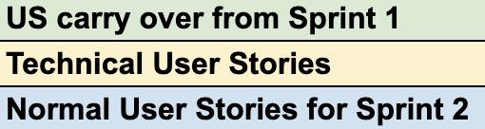
SPRINT 2 BACKLOG
US_ID | User Stories | Feature | Story Points
US_07 | As a patient, I want the uploaded image to be securely stored so that I can access my report anytime. | Image Handling | 3
US_08 | As a guest user, I want my uploaded image to be deleted after processing so that it doesn’t remain stored unnecessarily. | Image Handling | 2
US_09 | As a guest user, I want the system to alert me if my temporary image is unavailable after the session so that I can re-upload it. | Image Handling | 1
US_10 | As a patient, I want clear error messages if something goes wrong during upload or prediction so that I can take corrective actions. | Image Handling | 1
US_11 | As a patient, I want the app to recognize a wide range of skin conditions so that I can receive a diagnosis for diverse issues. | AI Diagnosis | 5
US_12 | As a patient, I want the diagnosis accuracy to be improved so that I can trust the AI’s results. | AI Diagnosis | 5
US_13 | As a patient, I want to receive the diagnosis result as soon as possible so that I can act quickly if needed. | AI Diagnosis | 2
US_14 | As a patient, I want to receive a brief description of the diagnosed condition so that I can understand about the skin issue I am facing. | AI Diagnosis | 2
US_15 | As a patient, I want to receive treatment recommendations so that I can take action towards treating my skin condition. | AI Diagnosis | 2
US_16 | As a patient, I want to view a comprehensive report of a case so that I have a complete record of my skin condition assessment. | Report | 5

Slide 47
SPRINT 2 BACKLOG
US_ID | User Stories | Feature | Story Points
US_17 | As a patient, I want to download a detailed report as a PDF so that I can share it with a dermatologist or keep it for personal records.. | Report | 1
US_18 | As a patient, I want the ability to print my report directly from the app so that I can have a hard copy when needed. | Report | 1
US_19 | As a patient, I want my reports to be secure and accessible only by me so that my medical data remains private. | Report Security and Privacy | 2
US_30 | As a patient, I want to sign up an account so that I can store my basic information and access personalized services. | User Account Management | 2
US_31 | As a dermatologist, I want to sign up so that I can access patient reports and provide professional feedback. | User Account Management | 2
US_32 | As a patient, I want to log in to my account so that I can manage my cases and view diagnoses. | User Account Management | 1
US_33 | As a dermatologist, I want to log in to my account so that I can manage patient reports and update case statuses. | User Account Management | 1
TU_04 | As a developer, I want to write a technical paper on the project so that I can document its technical aspects and design decisions for future reference. | Technical | 3
TU_05 | As a developer, I want to create test cases for Sprint 2 user stories so that I can verify the new functionality introduced in the Sprint 2. | Technical | 1

Slide 48
SPRINT 2 STORIES WITH TASK
Task | User Stories | Assignee
US_07 | As a patient, I want the uploaded image to be securely stored so that I can access my report anytime.
TK_01 | Configure Firebase Storage to organize images by patient ID and case ID. | zaid
TK_02 | Save image metadata (URL, case ID, timestamp, etc.) to Firestore. | zaid
TK_03 | Develop functionality to retrieve and display stored images on the patient’s dashboard | zaid
US_08 | As a guest user, I want my uploaded image to be deleted after processing so that it doesn’t remain stored unnecessarily.
TK_04 | Use temp/ directory for guest user images in Firebase Storage. | zaid
TK_05 | Schedule automatic deletion of images 5 minutes after upload using a setTimeout in the frontend or Firebase Cloud Function. | zaid
US_09 | As a guest user, I want the system to alert me if my temporary image is unavailable after the session so that I can re-upload it.
TK_06 | Implement checks for image validity after timeout. | zaid
TK_07 | Provide alerts and re-upload options if the image is unavailable. | Pujitha
US_10 | As a patient, I want clear error messages if something goes wrong during upload or prediction so that I can take corrective actions.

Slide 49
SPRINT 2 STORIES WITH TASK
Task | User Stories | Assignee
TK_08 | Add validation for file types and sizes during upload. | zaid
TK_09 | Display clear error messages for failed uploads or predictions. | zaid
US_11 | As a patient, I want the app to recognize a wide range of skin conditions so that I can receive a diagnosis for diverse issues.
TK_10 | Create a dataset | Lesley
TK_11 | Update the AI model to predict 20+ skin conditions | Abhi
TK_12 | Map predictions to readable condition names in the backend. | Tanzil
US_12 | As a patient, I want the diagnosis accuracy to be improved so that I can trust the AI’s results.
TK_13 | Retrain the AI model with additional datasets. | Tanzil
TK_14 | Test the model to ensure >80% accuracy for common conditions. | Abhi
TK_15 | Replace the existing model in the backend with the optimized version. | zaid
US_13 | As a patient, I want to receive the diagnosis result as soon as possible so that I can act quickly if needed.

Slide 50
SPRINT 2 STORIES WITH TASK
Task | User Stories | Assignee
TK_16 | Deploy the model to cloud infrastructure with GPU support for faster processing | Abhi
US_14 | As a patient, I want to receive a brief description of the diagnosed condition so that I can understand about the skin issue I am facing.
TK_17 | Create a dataset of symptoms and causes | Bangling
TK_18 | Store condition descriptions (symptoms, causes) in Firestore | Zaid
TK_19 | Fetch and display descriptions alongside diagnosis results. | Zaid
US_15 | As a patient, I want to receive treatment recommendations so that I can take action towards treating my skin condition.
TK_20 | Create a dataset of recommended treatments | Bangling
TK_21 | Store treatment recommendations for each condition in Firestore. | Zaid
TK_22 | Fetch and display recommendations alongside diagnosis results. | Zaid
US_16 | As a patient, I want to view a comprehensive report of a case so that I have a complete record of my skin condition assessment.
TK_23 | Create a report modal | Pujitha
TK_24 | Fetch and display all required data in the report. | Zaid

Slide 51
SPRINT 2 STORIES WITH TASK
Task | User Stories | Assignee
US_17 | As a patient, I want to download a detailed report as a PDF so that I can share it with a dermatologist or keep it for personal records..
TK_25 | Ensure the downloadable report matches the layout of the web report. | Zaid
US_18 | As a patient, I want the ability to print my report directly from the app so that I can have a hard copy when needed.
TK_26 | Implement a "Print" button that uses window.print() to print reports. | Pujitha
US_19 | As a patient, I want my reports to be secure and accessible only by me so that my medical data remains private.
TK_27 | Restrict report access to authenticated users using Firebase Authentication. | Zaid
TK_28 | Use Firestore security rules and encryption to protect patient data | Zaid
US_30 | As a patient, I want to sign up an account so that I can store my basic information and access personalized services.
TK_29 | Create a signup form and integrate Firebase Authentication to register patients, saving their details (name, email, UID) in Firestore. | zaid
TK_30 | Redirect successfully registered patients to their dashboard and display success or error messages. | zaid
US_31 | As a dermatologist, I want to sign up so that I can access patient reports and provide professional feedback.
TK_31 | Extend the signup form to allow dermatologist registration using Firebase Authentication and save their details in Firestore with the role as "dermatologist." | zaid

Slide 52
SPRINT 2 STORIES WITH TASK
TK_32 | Redirect successfully registered dermatologists to their dashboard and display appropriate messages. | zaid
US_32 | As a patient, I want to log in to my account so that I can manage my cases and view diagnoses.
TK_33 | Implement a login form and validate patient credentials using Firebase Authentication, fetching role-based data from Firestore. | zaid
TK_34 | Redirect patients to their dashboard upon successful login and display relevant error messages if login fails. | zaid
US_33 | As a dermatologist, I want to log in to my account so that I can manage patient reports and update case statuses.
TK_36 | Implement role-based authentication for dermatologists, validating credentials and retrieving their data from Firestore. | zaid
TK_37 | Redirect logged-in dermatologists to their dashboard to manage patient reports and display success/error feedback. | zaid
TU_04 | As a developer, I want to write a technical paper on the project so that I can document its technical aspects and design decisions for future reference. | lesley/zaid
TU_05 | As a developer, I want to create test cases for Sprint 2 user stories so that I can verify the new functionality introduced in the Sprint 2. | tanzil

Slide 53
SPRINT 2 TEST CASES
US_07 As a patient, I want the uploaded image to be securely stored so that I can access my report anytime.
TC | TC Title | Step Description | Expected Results | Execution Status | Execution date | Tester
TC_07_01 | Verify Secure Storage of Uploaded Image | 1. Upload an image. 2. Check the storage backend for the image file. 3. Verify the image is stored in the user's folder. | The image is stored securely in a user-specific folder and accessible only by the user. | Pass | Nov 20 | Tanzil
TC_07_02 | Verify Image Accessibility in Reports after downloading | 1. Open the report. 2. Check if the uploaded image is visible in the report after downloading | The uploaded image is displayed in the user’s report after downloading | Fail | Nov 20 | Tanzil
US_08 As a guest user, I want my uploaded image to be deleted after processing so that it doesn’t remain stored unnecessarily.
TC | TC Title | Step Description | Expected Results | Execution Status | Execution date | Tester
TC_08_01 | Verify Temporary Image Deletion for Guest Users | 1. Upload an image. 2. Wait for processing to complete. 3. Check storage for the uploaded image. | The uploaded image is deleted after processing. | Pass | Nov 20 | Tanzil
TC_08_02 | Verify Guest User's Image Is Not Retained | 1. Upload an image. 2. Wait for session expiry. 3. Check storage backend for the image. | The image is no longer stored in the system | Pass | Nov 20 | Tanzil

Slide 54
SPRINT 2 TEST CASES
US_09 As a guest user, I want the system to alert me if my temporary image is unavailable after the session so that I can re-upload it.
TC | TC Title | Step Description | Expected Results | Execution Status | Execution date | Tester
TC_09_01 | Verify Alert for Missing Temporary Image | 1. Attempt to retrieve a deleted image. 2. Observe the alert message. | An alert message is displayed: "The image is no longer available. Please re-upload." | Pass | Nov 20 | Tanzil
US_10 As a patient, I want clear error messages if something goes wrong during upload or prediction so that I can take corrective actions.
TC | TC Title | Step Description | Expected Results | Execution Status | Execution date | Tester
TC_10_01 | Verify File Type and Size Validation | 1. Attempt to upload an invalid file (e.g., PDF or a file >10MB). 2. Observe the validation message. | An error like "Invalid file type or size" is displayed. | Pass | Nov 20 | Tanzil
TC_10_02 | Verify Clear Error Messages for Failed Uploads | 1. Simulate an upload error (e.g., network disconnection). 2. Observe the error message. | An error like "Upload failed. Please check your network connection." is displayed. | Pass | Nov 20 | Tanzil

Slide 55
SPRINT 2 TEST CASES
US_11 As a patient, I want the app to recognize a wide range of skin conditions so that I can receive a diagnosis for diverse issues.
TC | TC Title | Step Description | Expected Results | Execution Status | Execution date | Tester
TC_11_01 | Verify Wide Range of Skin Conditions | 1. Upload images for various skin conditions. 2. Observe the diagnosis results. | The system recognizes all supported skin conditions. | Pass | Nov 20 | Tanzil
US_12 As a patient, I want the diagnosis accuracy to be improved so that I can trust the AI’s results.
TC | TC Title | Step Description | Expected Results | Execution Status | Execution date | Tester
TC_12_01 | Verify Model Retraining Improves Accuracy | 1. Test the retrained model with a validation dataset. 2. Compare accuracy before and after retraining. | Accuracy improves after retraining. | Fail | Nov 20 | Tanzil
US_13 As a patient, I want to receive the diagnosis result as soon as possible so that I can act quickly if needed.
TC | TC Title | Step Description | Expected Results | Execution Status | Execution date | Tester
TC_13_01 | Verify Quick Diagnosis Time | 1. Upload an image. 2. Measure the time taken for the diagnosis result. | The result is displayed within the expected time limit (e.g., 1 minute). | Pass | Nov 20 | Tanzil

Slide 56
SPRINT 2 TEST CASES
US_14 As a patient, I want to receive a brief description of the diagnosed condition so that I can understand about the skin issue I am facing.
TC | TC Title | Step Description | Expected Results | Execution Status | Execution date | Tester
TC_14_01 | Verify Description Display for Diagnosed Condition | 1. Upload a valid skin condition image. 2. Click "Predict Diagnosis". 3. Check the "Description" section. | A brief description of the diagnosed condition is displayed. | Pass | Nov 20 | Tanzil
US_15 As a patient, I want to receive treatment recommendations so that I can take action towards treating my skin condition.
TC | TC Title | Step Description | Expected Results | Execution Status | Execution date | Tester
TC_15_01 | Verify Treatment Recommendations Display | 1. Upload a valid image. 2. Click "Predict Diagnosis". 3. Check the "Treatment Recommendations" section. | 1. Upload a valid image. 2. Click "Predict Diagnosis". 3. Check the "Treatment Recommendations" section. | Pass | Nov 20 | Tanzil

Slide 57
SPRINT 2 TEST CASES
US_16 As a patient, I want to view a comprehensive report of a case so that I have a complete record of my skin condition assessment.
TC | TC Title | Step Description | Expected Results | Execution Status | Execution date | Tester
TC_16_01 | Verify Report Content for a Case | 1. Navigate to the reports section. 2. Open a specific case report. 3. Verify the report content. | The report includes details such as the uploaded image, diagnosis, description, treatment recommendations, and timestamps. | Pass | Nov 20 | Tanzil
US_17 As a patient, I want to download a detailed report as a PDF so that I can share it with a dermatologist or keep it for personal records..
TC | TC Title | Step Description | Expected Results | Execution Status | Execution date | Tester
TC_17_01 | Verify PDF Download Functionality | 1. Open a case report. 2. Click the "Download PDF" button. 3. Verify the downloaded file. | The patient is directed to their dashboard. | Fail | Nov 20 | Tanzil

Slide 58
SPRINT 2 TEST CASES
US_18 As a patient, I want the ability to print my report directly from the app so that I can have a hard copy when needed.
TC | TC Title | Step Description | Expected Results | Execution Status | Execution date | Tester
TC_18_01 | Verify Print Functionality | 1. Open a case report. 2. Click the "Print" button. 3. Verify the printer output. | The report is printed successfully. | Pass | Nov 20 | Tanzil
US_19 As a patient, I want my reports to be secure and accessible only by me so that my medical data remains private.
TC | TC Title | Step Description | Expected Results | Execution Status | Execution date | Tester
TC_19_01 | Verify Personal Details in Report | 1. Open a case report. 2. Check for the user’s name, email, and case details. | The report includes the user’s personal details such as name, email, and timestamp. | Pass | Nov 20 | Tanzil

Slide 59
SPRINT 2 TEST CASES
US_30 As a patient, I want to sign up an account so that I can store my basic information and access personalized services.
TC | TC Title | Step Description | Expected Results | Execution Status | Execution date | Tester
TC_30_01 | Verify Patient Sign-Up Functionality | 1. Navigate to the sign-up page. 2. Enter valid details (e.g., name, email, password). 3. Click "Sign Up". 4. Verify account creation. | The account is created successfully, and the patient is redirected to the home page. | Pass | Nov 20 | Tanzil
TC_30_02 | Handle Sign-Up with Existing Email | 1. Navigate to the sign-up page. 2. Enter an already registered email. 3. Click "Sign Up". 4. Observe the error message. | An error message "Email already in use" is displayed. | Pass | Nov 20 | Tanzil
US_31 As a dermatologist, I want to sign up so that I can access patient reports and provide professional feedback.
TC | TC Title | Step Description | Expected Results | Execution Status | Execution date | Tester
TC_31_01 | Verify Dermatologist Sign-Up Functionality | 1. Navigate to the dermatologist sign-up page. 2. Enter valid details (e.g., name, email, password). 3. Click "Sign Up". 4. Verify account creation. | The account is created successfully, and the dermatologist is redirected to the dashboard. | Fail | Nov 20 | Tanzil

Slide 60
SPRINT 2 TEST CASES
US_32 As a patient, I want to log in to my account so that I can manage my cases and view diagnoses.
TC | TC Title | Step Description | Expected Results | Execution Status | Execution date | Tester
TC_32_01 | Verify Patient Sign-Up Functionality | 1. Navigate to the sign-up page. 2. Enter valid details (e.g., name, email, password). 3. Click "Sign Up". 4. Verify account creation. | The account is created successfully, and the patient is redirected to the home page. | Pass | Nov 20 | Tanzil
TC_32_02 | Handle Invalid Login Credentials | 1. Navigate to the login page. 2. Enter an invalid email or password. 3. Click "Log In". 4. Observe the error message. | An error message like "Invalid email or password" is displayed. | Pass | Nov 20 | Tanzil
US_33 As a dermatologist, I want to log in to my account so that I can manage patient reports and update case statuses.
TC | TC Title | Step Description | Expected Results | Execution Status | Execution date | Tester
TC_33_01 | Verify Dermatologist Login Functionality | 1. Navigate to the login page. 2. Enter valid email and password. 3. Click "Log In". 4. Verify successful login. | The dermatologist is logged in successfully and redirected to the dashboard. | Fail | Nov 20 | Tanzil

Slide 61
SPRINT 2 STORIES COMPLETED AND NOT
US_ID | User Stories | Feature | Story Points | Completed
US_07 | As a patient, I want the uploaded image to be securely stored so that I can access my report anytime. | Image Handling | 3 | Y
US_08 | As a guest user, I want my uploaded image to be deleted after processing so that it doesn’t remain stored unnecessarily. | Image Handling | 2 | Y
US_09 | As a guest user, I want the system to alert me if my temporary image is unavailable after the session so that I can re-upload it. | Image Handling | 1 | Y
US_10 | As a patient, I want clear error messages if something goes wrong during upload or prediction so that I can take corrective actions. | Image Handling | 1 | Y
US_11 | As a patient, I want the app to recognize a wide range of skin conditions so that I can receive a diagnosis for diverse issues. | AI Diagnosis | 5 | Y
US_12 | As a patient, I want the diagnosis accuracy to be improved so that I can trust the AI’s results. | AI Diagnosis | 5 | N
US_13 | As a patient, I want to receive the diagnosis result as soon as possible so that I can act quickly if needed. | AI Diagnosis | 2 | Y
US_14 | As a patient, I want to receive a brief description of the diagnosed condition so that I can understand about the skin issue I am facing. | AI Diagnosis | 2 | Y
US_15 | As a patient, I want to receive treatment recommendations so that I can take action towards treating my skin condition. | AI Diagnosis | 2 | Y
US_16 | As a patient, I want to view a comprehensive report of a case so that I have a complete record of my skin condition assessment. | Report | 5 | Y

Slide 62
SPRINT 2 STORIES COMPLETED AND NOT
US_ID | User Stories | Feature | Story Points | Completed
US_17 | As a patient, I want to download a detailed report as a PDF so that I can share it with a dermatologist or keep it for personal records.. | Report | 1 | N
US_18 | As a patient, I want the ability to print my report directly from the app so that I can have a hard copy when needed. | Report | 1 | Y
US_19 | As a patient, I want my reports to be secure and accessible only by me so that my medical data remains private. | Report Security and Privacy | 2 | Y
US_30 | As a patient, I want to sign up an account so that I can store my basic information and access personalized services. | User Account Management | 2 | Y
US_31 | As a dermatologist, I want to sign up so that I can access patient reports and provide professional feedback. | User Account Management | 2 | N
US_32 | As a patient, I want to log in to my account so that I can manage my cases and view diagnoses. | User Account Management | 1 | Y
US_33 | As a dermatologist, I want to log in to my account so that I can manage patient reports and update case statuses. | User Account Management | 1 | N
TU_04 | As a developer, I want to write a technical paper on the project so that I can document its technical aspects and design decisions for future reference. | Technical | 3 | Y
TU_05 | As a developer, I want to create test cases for Sprint 2 user stories so that I can verify the new functionality introduced in the Sprint 2. | Technical | 1 | Y

Slide 63
METRICS - TEAM VELOCITY
Sprint 2 Velocity
Total Story Points: 42
Completed Story Points: 33
Velocity:33 story points

Slide 64
METRICS - Team's historical velocity (average)
The average of the previous sprints' velocities:
31 story points

Slide 65
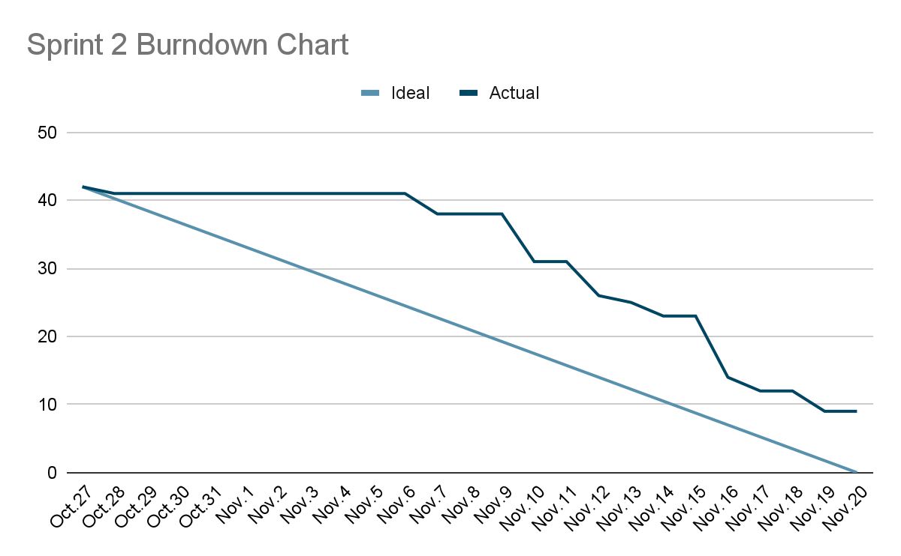
METRICS - BURNDOWN CHART

Slide 66
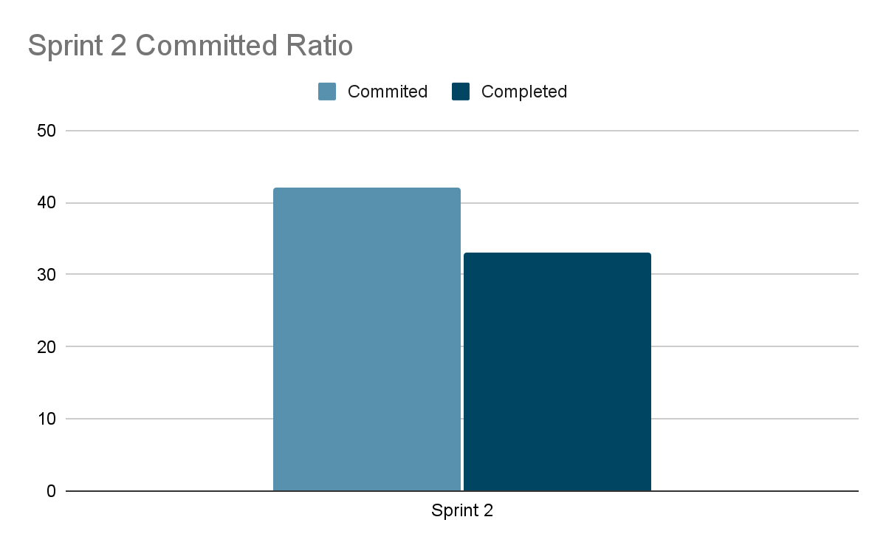
METRICS - COMMITTED RATIO
The committed ratio of Sprint 2 is 79%.
The average of the previous sprints' ratio: 83%

Slide 67
Sprint 2 Retrospective

Slide 68
Few important points from the Retrospective
What did we do right?
Finding sources and preparing a dataset was one hell of a task, and we did it
good team communication for resolving issues
Finding sources and preparing a dataset was one hell of a task, and we did it
Deadlines were set 1-2 days prior to the actually deadlines because of this we had time to encounter last minute issues
good atmosphere to learn, work and communicate. team members are patient and nice.
we began to code as soon as the planning meeting was done, giving enough development time to work on tasks

Slide 69
Few important points from the Retrospective
If we were to do it again, what would we do differently?
Instead of collaborating on a sample repository first and at the end pushing the code, we would do regular commits to the main repository, to highlight out workflow timeline
We would have started to write technical paper a little earlier rather than after completing the user stories
We would have spend initial days to do the tasks that had the highest priority, for example in this sprint- Preparing the dataset.
we would work more individually and parallel, not waiting to others Then start the next step work
We would start editing the presentation document and wiki page as soon as we are done with that particular part.

Slide 70
Few important points from the Retrospective
Action items
Instead of collaborating on a sample repository first and at the end pushing the code, we would do regular commits to the main repository, to highlight out workflow timeline Action Item: Assigned to Zaid: Make sure the code is on the main repository.
We would have started to write technical paper a little earlier rather than after completing the user stories Action items: Assigned to Abhi- Make sure the functional and non-functional tasks are going in parallely
We would have spend initial days to do the tasks that had the highest priority, for example in this sprint- Preparing the dataset. Action item: Assigned to Tanzil - Make sure the tasks with highest priority are done first in the planning meeting
we would work more individually and parallel, not waiting to others Then start the next step work Action items: Assigned to Abhi- Make sure the functional and non-functional tasks are going in parallely
We would start editing the presentation document and wiki page as soon as we are done with that particular part. Action items: Assigned to Everyone - Update ppt regulary. Assigned to Zaid- Update wiki page regularly

Slide 71
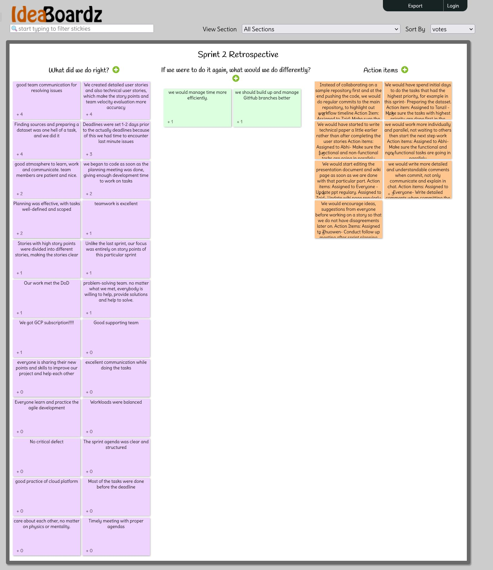
SPRINT 2 RETROSPECTIVE

Slide 72
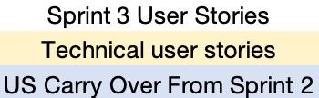
SPRINT 3 - PLANNING AND BACKLOG
US_ID | User Stories | Feature | Story Points | Completed | Date
US_12 | As a patient, I want the diagnosis accuracy to be improved so that I can trust the AI’s results. | AI Diagnosis | 5
US_17 | As a patient, I want to download a detailed report as a PDF so that I can share it with a dermatologist or keep it for personal records.. | Report | 1
US_31 | As a dermatologist, I want to sign up so that I can access patient reports and provide professional feedback. | User Account Management | 2
US_33 | As a dermatologist, I want to log in to my account so that I can manage patient reports and update case statuses. | User Account Management | 1
US_20 | As a patient, I want to view my past cases and track their statuses, so that I can monitor my health progress and stay informed about the evaluations. | User Account Management | 2
US_21 | As a dermatologists, I want to access and view patient reports so that I can assess their conditions and provide professional feedback. | User Account Management | 2
US_22 | As a dermatologist, I want to add my diagnosis to patient reports so that I can contribute my professional assessment to the patient's case. | Derm Review | 2
US_23 | As a dermatologist, I want to add comments to patient reports so that I can provide addditional guidance if necessary. | Derm Review | 1

Slide 73
SPRINT 3 - PLANNING AND BACKLOG
US_ID | User Stories | Feature | Story Points | Completed | Date
US_24 | As a patient, I want to be notified as soon as my report is reviewed by a dermatologist so that I can stay informed about my case status. | Derm Review | 2
US_25 | As a patient, I want to access a chat interface from my report page so that I can communicate directly with a dermatologist. | Chat | 2
US_26 | As a patient, I want to message my dermatologist in real time so that I can get quick answers to my questions. | Chat | 4
US_27 | As a patient, I want to send images to dermatologist so that I can provide additional visual information about my skin condition. | Chat | 2
US_28 | As a patient, I want to review the chat history with my dermatologist so that I can refer back to previous discussions and recommendations. | Chat | 3
US_29 | As a dermatologist, I want to chat with patients in real-time so that I can provide personalized consultation and answer their questions. | Chat | 4

Slide 74
SPRINT 3 - TECHNICAL USER STORIES
US_ID | User Stories | Feature | Story Points | Completed | Date
TU_06 | As a developer, I want to create an installation manual for the project so that users can easily set up the application in their environment. | Technical | 2
TU_07 | As a developer, I want to create comprehensive API documentation so that other developers can integrate with and use the API effectively. | Technical | 2
TU_08 | As a developer, I want to create test cases for Sprint 3 user stories so that I can verify the new functionality introduced in the Sprint 3. | Technical | 1

Slide 75
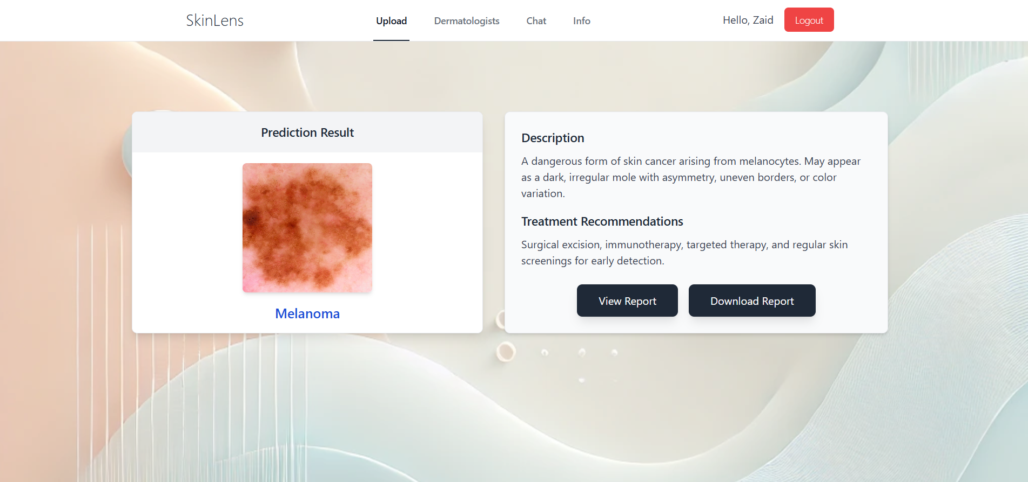
PROJECT DEMO - SCREENSHOT

Slide 76
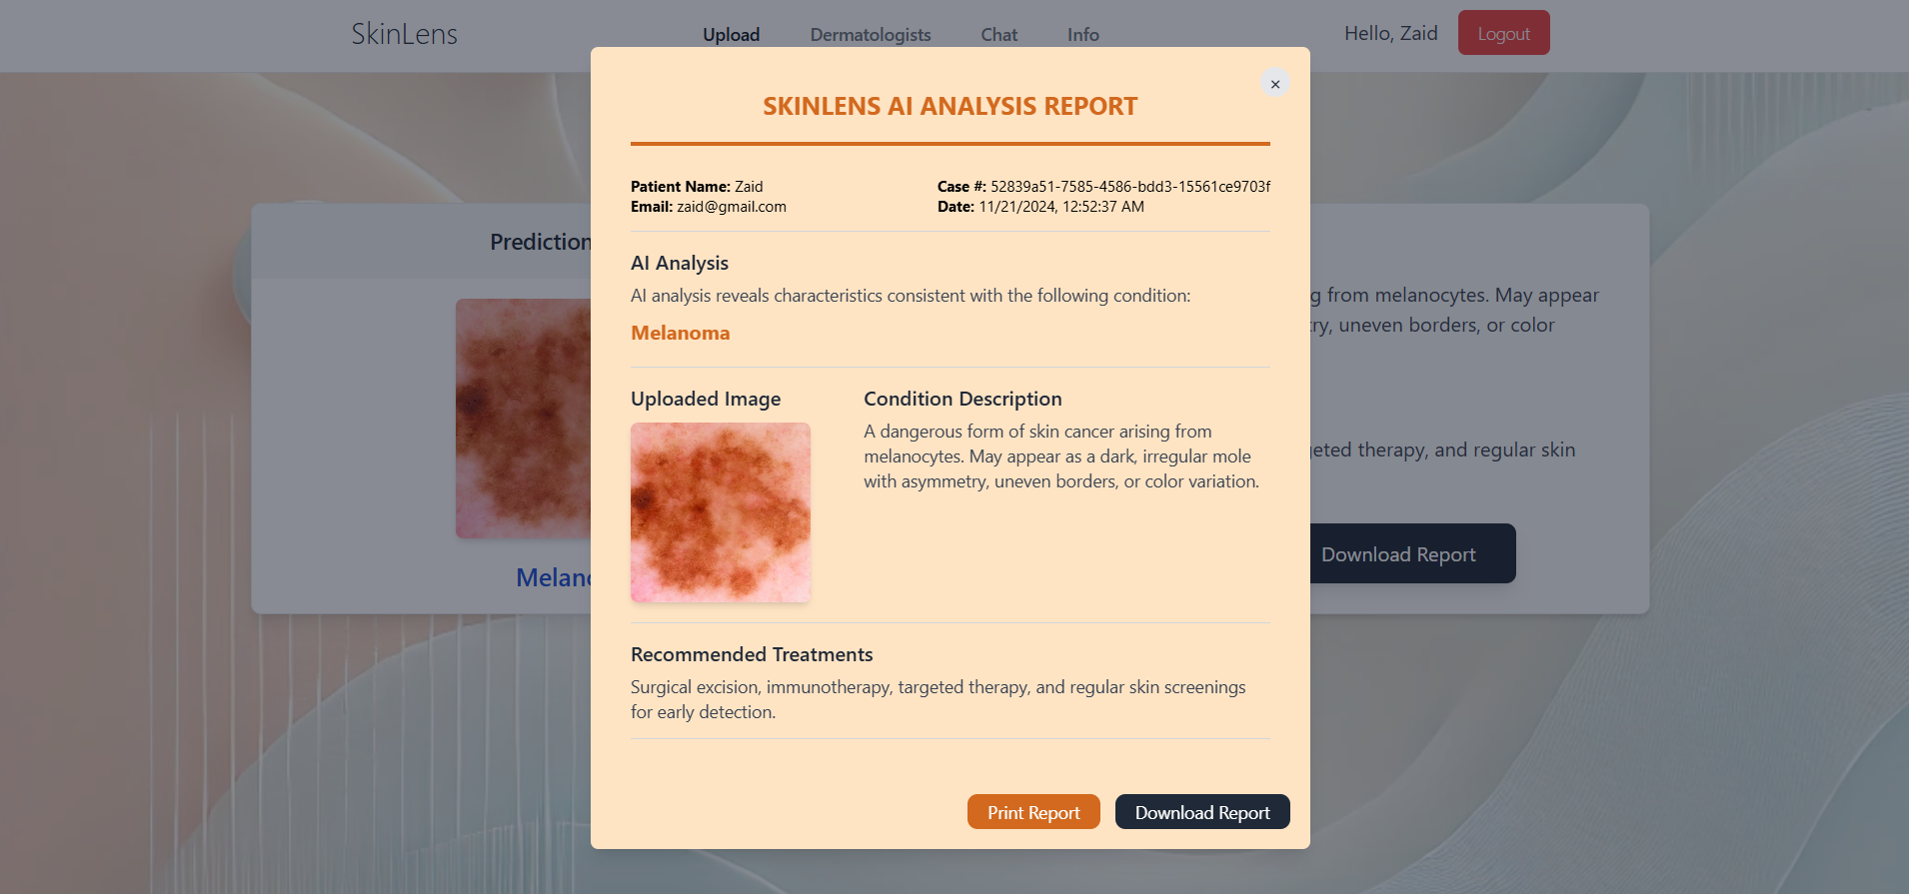
PROJECT DEMO - SCREENSHOT

Slide 77
PROJECT - APIs
1. Image Upload API
Purpose: Uploads the user's image to Firebase Storage and generates a unique URL for accessing it.
Method: Indirectly through Firebase Storage SDK
Process:
Input: Image file selected by the user.
Output: URL of the uploaded image.
Key Code:
const storage = getStorage();
const storageRef = ref(storage, `cases/${user.uid}/${uuidv4()}/${file.name}`);
await uploadBytes(storageRef, file);
const downloadURL = await getDownloadURL(storageRef);

Slide 78
PROJECT - APIs
2. AI Prediction API
Endpoint: /predict
Purpose: Sends the uploaded image URL to the backend AI model for processing and returns a predicted diagnosis.
Method: POST
Input:
imageUrl (String): The URL of the uploaded image.
Output:
prediction (String): The predicted skin condition.
Example response: { "prediction": "Melanoma" }
Key Code:
const response = await axios.post("http://localhost:5000/predict", { imageUrl });
const predictedDisease = response.data.prediction;

Slide 79
PROJECT - APIs
3. Fetch Disease Details API
Purpose: Fetches description and treatment recommendations for a specific skin condition from Firestore.
Method: Firebase Firestore Query
Input:
predictedDisease (String): The name of the predicted skin condition.
Output:
description (String): A brief description of the condition.
treatment (String): Recommended treatment.
Key Code:
const diseasesRef = collection(db, "diseases");
const q = query(diseasesRef, where("disease", "==", predictedDisease));
const querySnapshot = await getDocs(q);

Slide 80
PROJECT - APIs
4. Save Case Details API
Purpose: Saves case details (uploaded image, prediction, description, and treatment) in Firestore for logged-in users.
Method: Firebase Firestore setDoc
Input: Case details (JSON)
Output: None
Key Code:
await setDoc(doc(collection(db, "cases"), newCaseId), {
caseId: newCaseId,
patientId: user.uid,
patientEmail: user.email,
patientName: user.name,
imageUrl: downloadURL,
prediction,
description,
treatment,
timestamp: new Date().toISOString(),
});

Slide 81
PROJECT - APIs
5. Retrieve Case Details API
Purpose: Retrieves case details for a logged-in user, including image URL, prediction, description, and treatment.
Method: Firebase Firestore Query
Input:
caseId (String): Unique identifier for the case.
Output: Case details (JSON)
Key Code:
const q = query(collection(db, "cases"), where("caseId", "==", caseId));
const querySnapshot = await getDocs(q);

Slide 82
PROJECT - APIs
6. Temporary Image Deletion API
Purpose: Deletes temporary images for guest users after a certain timeout period.
Method: Firebase Storage deleteObject
Input:
imageUrl (String): URL of the uploaded image.
Output: None.
Key Code:
const storage = getStorage();
const imageRef = ref(storage, imageUrl);
await deleteObject(imageRef);

Slide 83
PROJECT - APIs
7. Authentication APIs
Sign-Up API
Purpose: Creates a new user account and stores user details (name, role, email) in Firestore.
Method: Firebase Authentication + Firestore setDoc
Key Code:
const userCredential = await createUserWithEmailAndPassword(auth, email, password);
await setDoc(doc(db, "users", userCredential.user.uid), { name, email, role, uid: userCredential.user.uid });
Login API
Purpose: Logs in a user with email and password.
Method: Firebase Authentication signInWithEmailAndPassword
await signInWithEmailAndPassword(auth, email, password);

Slide 84
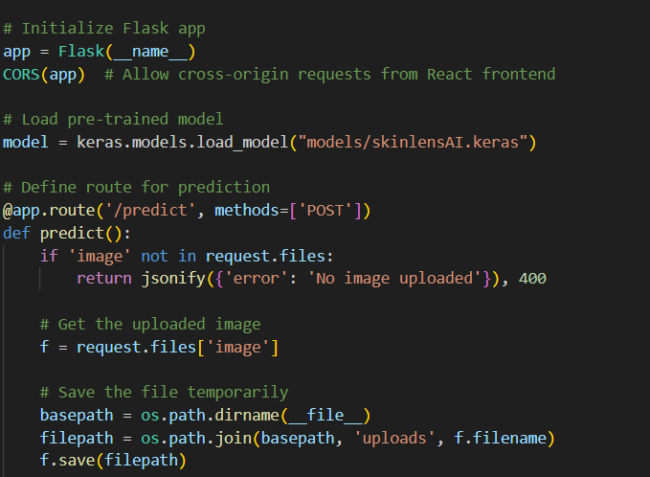
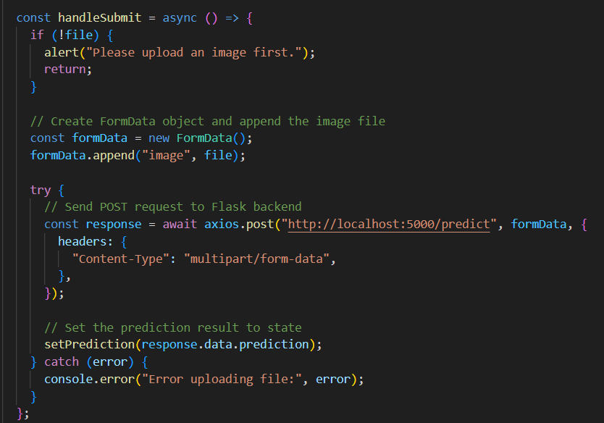
PROJECT - APIs
Flask API and CORS
Axios

Slide 85

WIKI PAGE LINK
To see our progress
https://github.com/htmw/2024F-Biased/wiki

Slide 86
DEMO

Slide 87
THANK YOU!

